Slide 1
Artificial intelligence systems Lecture 3
Associate professor of SEMIT department,
Ph.D.. Goloskokova Anna

Slide 2
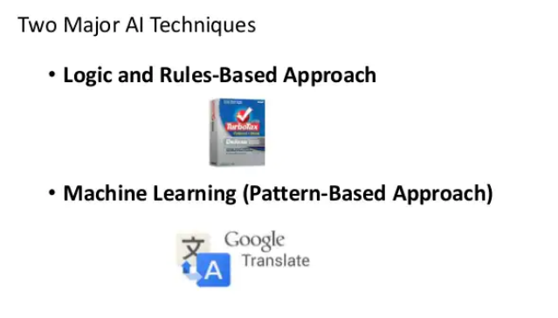
Major AI Approaches

Slide 3
The Key Differences Between Rule-Based AI And Machine Learning
Rule-based systems and machine learning models are widely utilized to make conclusions from data.
Both of these approaches have advantages and disadvantages.
The correct AI strategy is very crucial for the development of the business. The emerging technologies such as machine learning and artificial intelligence contribute a lot in development and productiveness. Machine learning certification provides you a deep insight into the industry.

Slide 4
What is rule-based Artificial Intelligence?
A system that accomplishes artificial intelligence through a rule-based model is known as rule-based AI systems. There is no doubt that the demand for artificial intelligence developer is increasing day by day. A rule-based artificial intelligence produces pre-defined outcomes that are based on a set of certain rules coded by humans. These systems are simple artificial intelligence models which utilize the rule of if-then coding statements. The two major components of rule-based artificial intelligence models are “a set of rules” and “a set of facts”. You can develop a basic artificial intelligence model with the help of these two components.

Slide 5
What is rule-based Artificial Intelligence?
In particular, from the technological viewpoint, the logic-based technologies
developed in over 60 years can be classified as technologies capable of responding to the needs of
(i) knowledge representation,
(ii) reasoning,
(iii) model-checking and verification—the first two leading
in their turn to expert systems and intelligent systems, which aim to mimic the human behavior.

Slide 6
What is Machine learning?
A system that accomplishes artificial intelligence through machine deep learning is known as a learning model. The machine learning system defines its own set of rules that are based on data outputs. It is an alternative method to address some of the challenges of rule-based systems. ML systems only take the outputs from the data or experts. ML systems are based on a probabilistic approach. ml certification provides practical training of large datasets.

Slide 7
Difference between rule-based AI and machine learning
The key difference between rule-based artificial intelligence and machine learning systems are listed as below:
1. Machine learning systems are probabilistic and rule-based AI models are deterministic. Machine learning systems constantly evolve, develop and adapt its production in accordance with training information streams. Machine learning models utilize statistical rules rather than a deterministic approach.
2. The other major key difference between machine learning and rule-based systems is the project scale. Rule-based artificial intelligence developer models are not scalable. On the other hand, machine learning systems can be easily scaled.

Slide 8
Difference between rule-based AI and machine learning
3. Machine learning systems require more data as compared to rule-based models. Rule-based AI models can operate with simple basic information and data. However, machine learning systems require full demographic data details.
4. Rule-based artificial intelligence systems are immutable objects. On the other hand, machine learning models are mutable objects that enable enterprises to transform the data or value by utilizing mutable coding languages such as java.

Slide 9
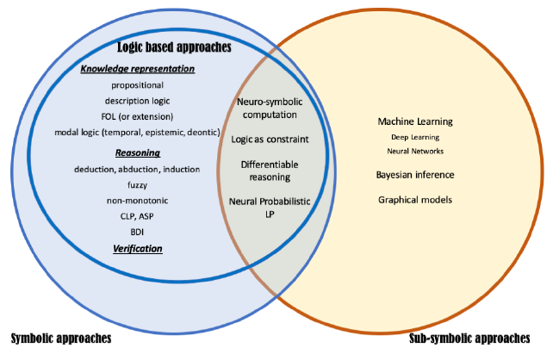
A graphical view of symbolic and sub-symbolic approaches highlighting the role of logic-based technologies along with their main classification.

Slide 10
When to utilize machine learning models
Pure coding processing
Pace of change
Simple guidelines don’t apply

Slide 11
When to utilize rule-based models
Not planning for machine learning
Danger of error
Speedy outputs

Slide 12
Conclusion
Machine learning and rule-based models have their own advantages and disadvantages. It totally depends on the situation that which approach is appropriate for the development of business. Several business projects initiate with a rule or excerpt based models to understand and explore the business. On the other hand, machine learning systems are better for long terms as it is more manageable to constant improvement and enhancement through algorithm and data preparation. As the world of large datasets increases, it’s time to glance beyond binary outputs by utilizing a probabilistic rule rather than a deterministic approach.

